Slide 1
Chapter 12
Moral Development
Notes:
Add slide notes here

Slide 2
Perspectives on Moral Development
Three basic components of morality
  Emotional component
    Feelings regarding right or wrong actions that motivate moral thoughts
  Cognitive component
    How we think about right and wrong and make decisions about how to behave
  Behavioral component
    How we behave when we experience the temptation to cheat or are called upon to help a needy person

Slide 3
Moral Reasoning: Cognitive-Developmental Theory
Cognitive-developmental theorists study morality via development of moral reasoning
  Thinking process is involved in deciding whether an act is right or wrong
  Moral development is assumed to depend on social cognitive development
  Moral reasoning is said to progress through universal stages

Slide 4
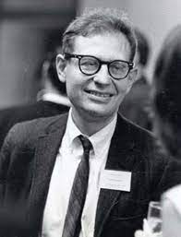
Moral Reasoning
Lawrence Kohlberg
  Studied the development of moral reasoning
  Presented individuals with moral dilemmas, analyzed how they responded

Slide 5
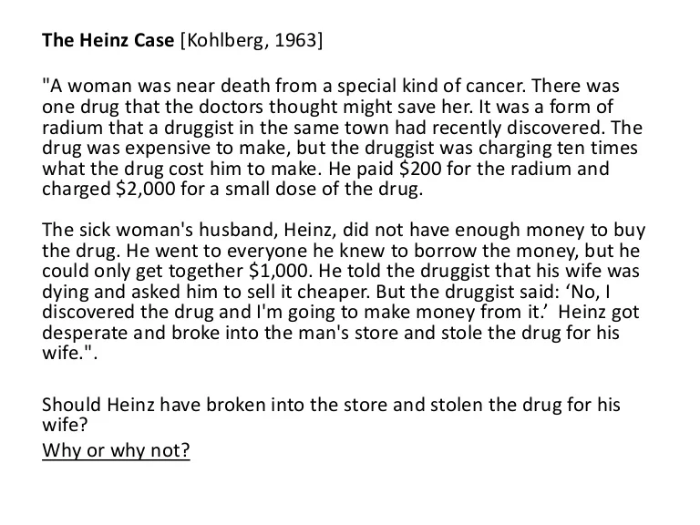

Slide 6
Kohlberg’s Stages of Moral Reasoning (1 of 3)
  Moral growth progresses through three broad moral levels
    Preconventional morality: rules are external to the self rather than internalized (about age 9)
    Stage 1: Punishment-and-Obedience Orientation
      The goodness or badness of an act depends on its consequences
    Stage 2: Instrumental Hedonism
      A person at the second stage of moral development conforms to rules to gain rewards or satisfy personal needs

Slide 7
Kohlberg’s Stages of Moral Reasoning (2 of 3)
Conventional morality: individual has internalized various moral values (9 to adolescence)
  Stage 3: “Good Boy” or “Good Girl” Morality
    What is right is now what pleases, helps, or is approved by others. People are often judged by their intentions.
  Stage 4: Authority and Social Order-Maintaining Morality
    Now what is right is what conforms to the rules of legitimate authorities and is good for society as a whole.

Slide 8
Kohlberg’s Stages of Moral Reasoning (3 of 3)
Postconventional morality: individual defines what is right in terms of broad principles of justice.
  Stage 5: Morality of Contract, Individual Rights, and Democratically Accepted Law
    There is an understanding of the underlying purpose of laws, concern that rules should be arrived through a democratic consensus
  Stage 6: Morality of Individual Principles of Conscience
    Individual defines right and wrong on the basis of self-generated principles

Slide 9
Evaluating Kohlberg's Theory
Assessing Moral Reasoning
Much of Kohlberg’s theory was based on longitudinal research with a group of boys, ages 10, 13, and 16, who were interviewed over three decades.
The Heinz dilemma—participants’ explanations of how they arrived at decisions reveal developmental shifts through the broad levels of reasoning that correspond to cognitive development (preconventional, conventional, and postconventional stages).
Research postconventional reasoning is rare in adults and appears as Stage 5 reasoning.
Notes:
LO 12-1: Summarize the development of moral reasoning and its influences, from childhood into adulthood.
C. Assessing Moral Reasoning
a. Much of Kohlberg’s theory was based on longitudinal research with a group of boys, ages 10, 13, and 16, who were interviewed over three decades
b. The Heinz dilemma—participants’ explanations of how they arrived at decisions reveal developmental shifts through the broad levels of reasoning that correspond to cognitive development
i. Preconventional: should not steal the drug because he will go to prison; should steal the drug because to avoid his wife’s anger/receive her affection
ii. Conventional: should steal the drug because good people help their wives/it is his duty as a husband; should not steal the drug because good people do not steal/following rules maintains social order
iii. Postconventional: stealing is against the law, but laws are intended to help people and, stealing the drug is intended to help Heinz’s wife: the value of life is exponentially greater than the drug
c. Research suggests few people advance beyond conventional moral reasoning; postconventional reasoning is rare in adults and appears as Stage 5 reasoning
d. Research has not supported the existence of Stage 6

Slide 10
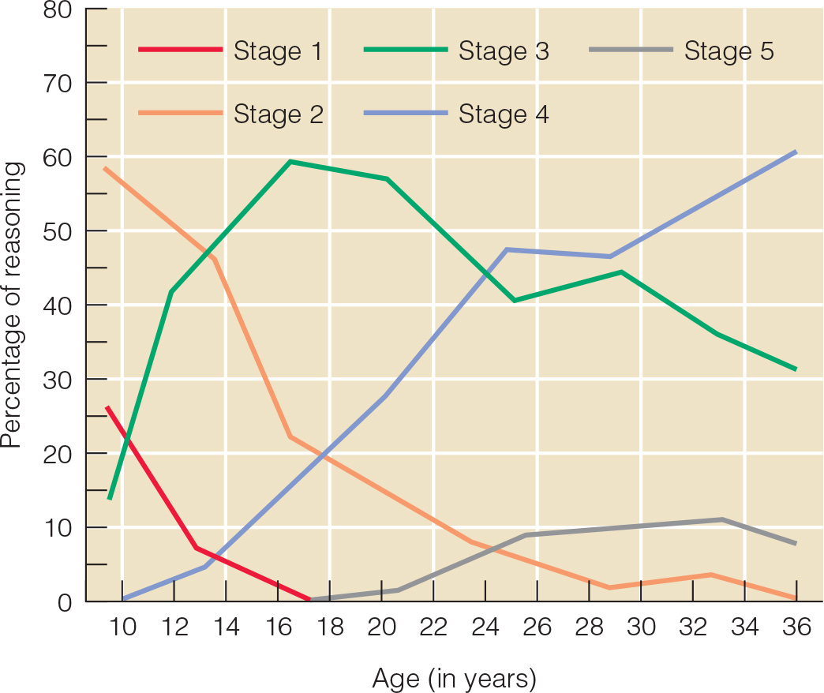
Changes in Moral Reasoning
Notes:
Figure 13.2 Average percentage of moral reasoning at each of Lawrence Kohlberg’s stages for males from age 10 to age 36.

Slide 11
Moral Emotion: Psychoanalytic Theory and Beyond (1 of 2)
Moral Reasoning: the thinking process involved in deciding whether an act is right or wrong
Empathy
  Vicarious experiencing of another person’s feelings
  Important for moral development
  Can motivate prosocial behavior
    Positive social acts
  Keep us from engaging in antisocial behavior

Slide 12
Moral Emotion: Psychoanalytic Theory and Beyond (2 of 2)
Children must internalize moral standards to behave morally even when no authority figure is present
  Prosocial behavior: positive social acts, that reflect concern for the welfare of others
  Antisocial behavior: behavior that violates social norms, rules, laws, etc.

Slide 13
Prosocial Behavior (1 of 3)
Empathy: capacity to understand someone’s feelings.
Prosocial behavior: voluntary behavior to benefit another.
  Prosocial Behavior in Infancy and Early Childhood
  18–24 months: increasingly prosocial responses to others’ emotional and physical distress, but responses are limited.
Instrumental assistance: tangible help.
  Young children engage in prosocial behavior for egocentric motives.
  As theory of mind develops, children’s prosocial behavior becomes motivated by empathy and internalized values.
Notes:
LO 12-2: Analyze the progression of prosocial behavior and its contextual influences.
II. Prosocial Behavior
A. Empathy: the capacity to understand someone’s feelings
B. Prosocial behavior: voluntary behavior intended to benefit another
C. Prosocial Behavior in Infancy and Early Childhood
a. As early as 18 months: prosocial behavior is simple, such as the tendency to help by picking up markers that have fallen
b. Between 18-24 months: increasingly prosocial responses to others’ emotional and physical distress, but responses are limited by poor perspective taking ability
c. Spontaneous prosocial behavior not prompted by adults is rare in toddlerhood
d. Instrumental assistance: tangible help
e. Young children engage in prosocial behavior for egocentric motives
f. As theory of mind develops, children’s prosocial behavior becomes motivated by empathy for others and internalized values

Slide 14
Prosocial Behavior (2 of 3)
Sharing
  3–5 years: selectivity in sharing, valuing others they know.
    Young children’s perspectives on sharing shifts from an emphasis on equality to equity and they begin to consider others’ wealth.
  7–8 years: take merit and disadvantage into account.
    With age, children of all cultures increasingly prefer equitable distributions, but cultural values influence how they explain their choices.
Notes:
LO 12-2: Analyze the progression of prosocial behavior and its contextual influences.
D. Sharing
a. Children’s Reasoning About Sharing
i. Despite norms of sharing, 3, 4, and 6-year-olds favor themselves but become more likely to share with age
ii. Sharing is influenced by context
iii. Between 3-5 years: selectivity in sharing, valuing others they know who display prosocial behaviors
iv. Young children’s perspectives on sharing shifts from an emphasis on equality to equity and they begin to consider others’ wealth
v. 7-8 years: take merit and disadvantage into account
b. Culture and Sharing
i. Culture subtly influences children’s ideas about sharing and fairness
ii. 4-11-year-olds of varying cultures shifted from equality‐based to equity‐based distribution, but the age and degree at which children favored equity varied with countries’ levels of individualism and collectivism
iii. Example: Filipino versus American fifth graders’ explanation of choices was related to their culture
iv. With age, children of all cultures increasingly prefer equitable distributions, but cultural values influence how they explain their choices

Slide 15
Prosocial Behavior (3 of 3)
Prosocial Behavior in Adolescence
  Empathic concern: ability to understand and feel concern for another’s emotional experience.
  With advances in perspective taking, emotional control, and cognitive capacities, prosocial behavior increases into early adulthood.
  Prosocial behavior is associated with positive peer relationships, mental health, academic performance, and social competence and approval.
Notes:
LO 12-2: Analyze the progression of prosocial behavior and its contextual influences.
E. Prosocial Behavior in Adolescence
a. Prosocial reasoning tends to improve in adolescence alongside improvements in moral reasoning, but prosocial behavior can show more mixed changes over adolescence
b. Generally, adolescents report more prosocial behavior toward friends; prosocial behavior toward family remains stable/decreases and increases toward friends over time
c. Empathic concern: the ability to understand and feel concern for another’s emotional experience
d. With advances in perspective taking, emotional control, and cognitive capacities, prosocial behavior increases into early adulthood
e. Brain development influences adolescents’ ability to regulate their emotions and behavior, and prosocial behavior may show longitudinal associations with brain development
F. Prosocial Behavior and Adjustment
a. In childhood, prosocial behavior is associated with positive peer relationships, mental health, social competence, and academic performance
b. In adolescence, prosocial behavior is associated self-esteem, social competence and approval, academic achievement, and high quality relationships
c. Longitudinal research suggests prosocial behavior is negatively associated with internalizing and externalizing problems

Slide 16
Antisocial Behavior
Richard Tremblay proposes that humans:
  Do not need to learn to be aggressive
  Need to learn how not to be aggressive
Frequency of aggression normally rises from infancy to a peak around age four or five and then decreases

Slide 17
Aggression and Antisocial Behavior (1 of 3)
Instrumental aggression: used to achieve a goal, such as obtaining a toy, which is the most common form of aggression seen in infancy and early childhood.
Verbal aggression: form of relational aggression that utilizes language
Relational aggression: intended to harm others’ social relationships.
  Individual differences in expressing anger are apparent by 6 months of age and persist through early childhood.
  Aggressive tendencies may be heritable, suggesting a biological component.
Notes:
LO 12-3: Examine common forms of aggressive and antisocial behavior in childhood and adolescence.
III. Aggression and Antisocial Behavior
A. Aggression
a. Instrumental aggression: aggression used to achieve a goal, such as obtaining a toy, which is the most common form of aggression seen in infancy and early childhood
b. Verbal aggression: a form of relational aggression that utilizes language
c. Relational aggression: aggression intended to harm others’ social relationships
d. Most children learn to inhibit aggressive impulses, but a small minority of children show high levels of aggression and are more likely to have experienced coercive parenting, family dysfunction, and low income
e. Individual differences in expressing anger are apparent by 6 months of age and persist through early childhood
f. Aggressive tendencies may be heritable, suggesting a biological component

Slide 18
Aggression and Antisocial Behavior (2 of 3)
Bullying (peer victimization):
  ongoing interaction in which a child or adolescent repeatedly attempts to inflict physical, verbal, or social harm on another
  Estimated rates of bullying range from 15-25% of children.
Notes:
LO 12-3: Examine common forms of aggressive and antisocial behavior in childhood and adolescence.
B. Bullying
a. Bullying (peer victimization): an ongoing interaction in which a child or adolescent repeatedly attempts to inflict physical, verbal, or social harm on another by hitting, kicking, name-calling, teasing, shunning, or humiliating them
b. Estimated rates of bullying range from 15-25% of children

Slide 19
Aggression and Antisocial Behavior (3 of 3)
Children Who Bully
  Boys show physical aggression; girls use verbal/relational aggression.
  Pursuit of high status and maintaining a dominant position.
Victims of Bullying
  Victims report intrusive parenting, overprotectiveness, and criticism.
  Repeated victimization associated with negative emotional, academic, and behavioral correlates.
Notes:
LO 12-3: Examine common forms of aggressive and antisocial behavior in childhood and adolescence.
c. Children Who Bully
i. Boys who bully tend to show physical aggression, and target both boys and girls
ii. Girls who bully tend to target other girls, using verbal and relational aggression
iii. Bullying can be motivated by the pursuit of high status and maintaining a powerful dominant position in the peer group
iv. Children and adolescents who bully tend to experience maladaptive parenting (e.g., coercive control and physical discipline)
d. Victims of Bullying
i. Victims report experiencing intrusive parenting, overprotectiveness, and criticism
ii. Children can respond to bullying by avoiding contact or in ways that reinforce bullies
iii. Older children who experience frequent victimization can be more likely to show reactive aggression
iv. Bully-victims: children who share characteristics of both bullies and victims
v. Bully-victims often display high levels of anxiety and depression and low rates of social acceptance and self-esteem, but they also show more aggression, impulsivity, and poor self-control
vi. Repeated victimization is associated with negative emotional, academic, and behavioral correlates that may persist into adulthood

Slide 20
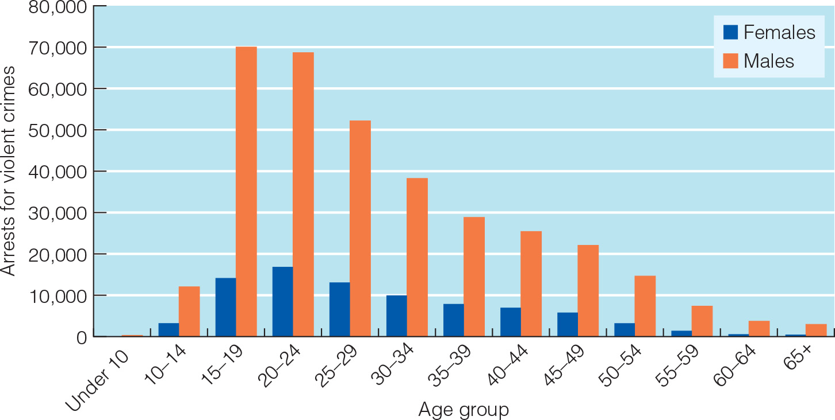
Violent Crime Among Males and Females
Notes:
Figure 13.3 Arrests for violent crimes by males and females of different ages in the United States, 2010.

